Slide 1


World Happiness Report
Uroš Petković, Andre Novikov, Axana Raiser & Jennifer Dersjant

Slide 2
RESEARCH QUESTION
What are relevant factors that drive a nation’s happiness?
“
What are relevant factors that drive a nation’s happiness?
”

Slide 3









PROCESS
Step 4
Correlation calculations and model predictions
Step 1
Data cleaning using Python with the packages Pandas and Numpy
Iterative process
Step 3
Visualisations of the data to answer the research question
Step 2
Checking and solving data for distribution, multicollinearity, outliers and nulls

Slide 4
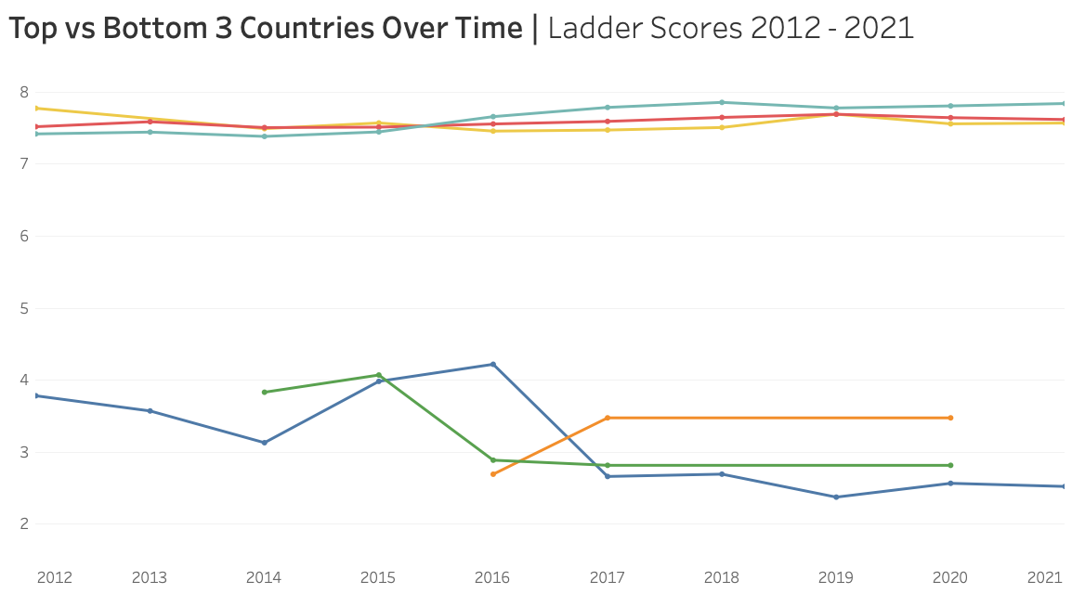
Ladder
Score
ranging
from
1-10
■ Finland ■ Denmark ■ Switzerland ■ South Sudan ■ Central African Republic ■ Afghanistan

Slide 5
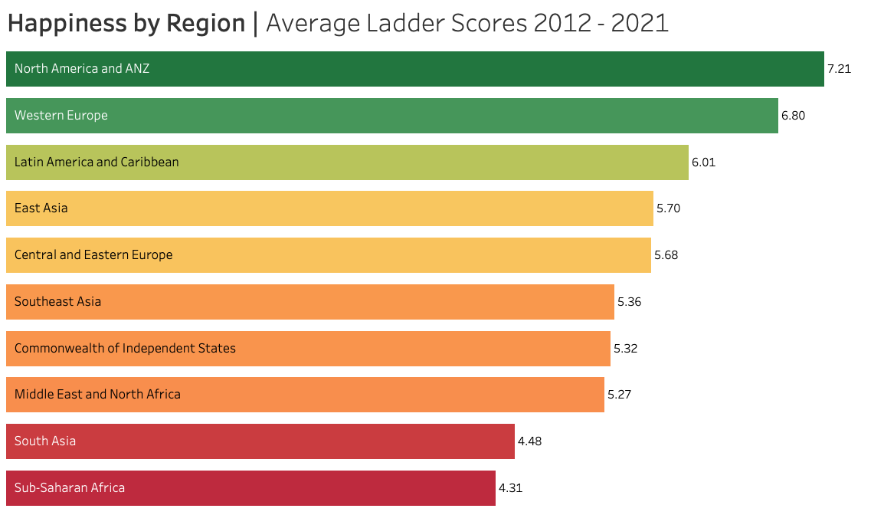
(Post-Sovjet Republic)

Slide 6
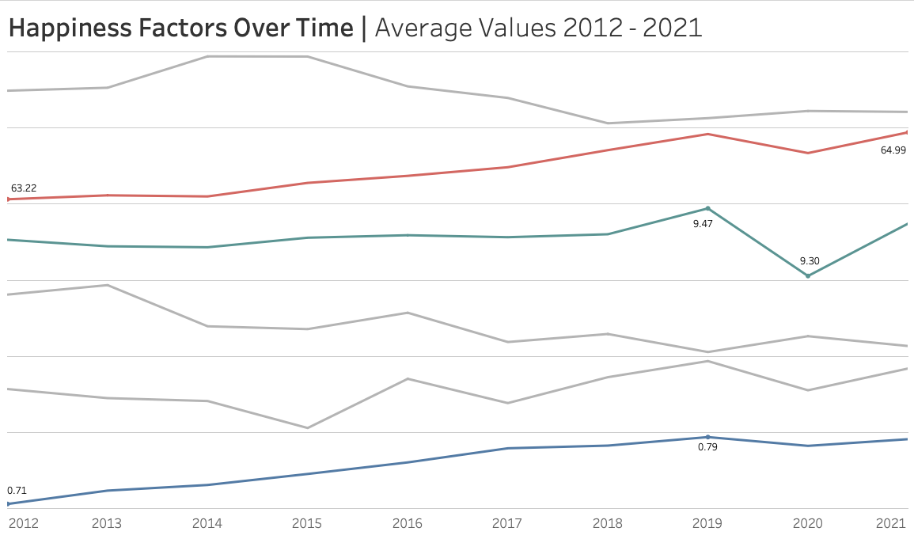
Generosity
Healthy Life Expectancy
Logged GDP Per Capita
Perception of Corruption
Social Support
Freedom to Make Life Choices

Slide 7
CORRELATIONS
0.78
0.77
0.73
Ladder Score &
Logged GDP per Capita
Ladder Score &
Healthy Life Expectancy
Ladder Score &
Social Support
0.54
-0.41
0.12
Ladder Score &
Freedom to Make Life Choices
Ladder Score &
Perception of Corruption
Ladder Score &
Generosity

Slide 8
Key takeaways
Money does not necessarily make happy, but the lack of it makes unhappy
GDP & Healthy Life Expectancy
Future research should focus on nation-level analysis

Slide 9

Questions?

